Slide 1

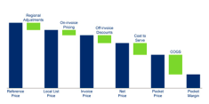

Case example: A packaging company stringently implemented new commercial capabilities and operating model achieving ~250% margin improvement
Basic Materials (GEM) | Asia-Pacific
BAS024
Sales
Pocket Margin
CASE EXAMPLE
Business development of 1 out of 4 BUs
Stringent implementation
of capabilities and OpModel
Business development
USD bn, simplified
Quantified and proven impact
  Invest in commercial capability building (e.g., dedicated trainers)
  On-board new co-workers from Day-1 onwards
  Run a disciplined business review process
    Dedicated commercial Review Teams
    Schedule prep. & review meetings at the beginning of the fiscal year
  10% top-line growth in mature markets
  250% bottom-line growth through reducing cost leakages at plant level and systematic capturing of all opportunities (disciplined action tracking)
+~10%
~250%
3.70
2.80
PMDB
0.14
Reviews and tracking
Y0
Y1
Y2
Y3
Y4
Y5
Y6
Y7
Y8
Y9
Y10

